Slide 1
Egeria architecture and philosophy – the deep stuff
Mandy Chessell CBE FREng
IBM Distinguished Engineer

Slide 2
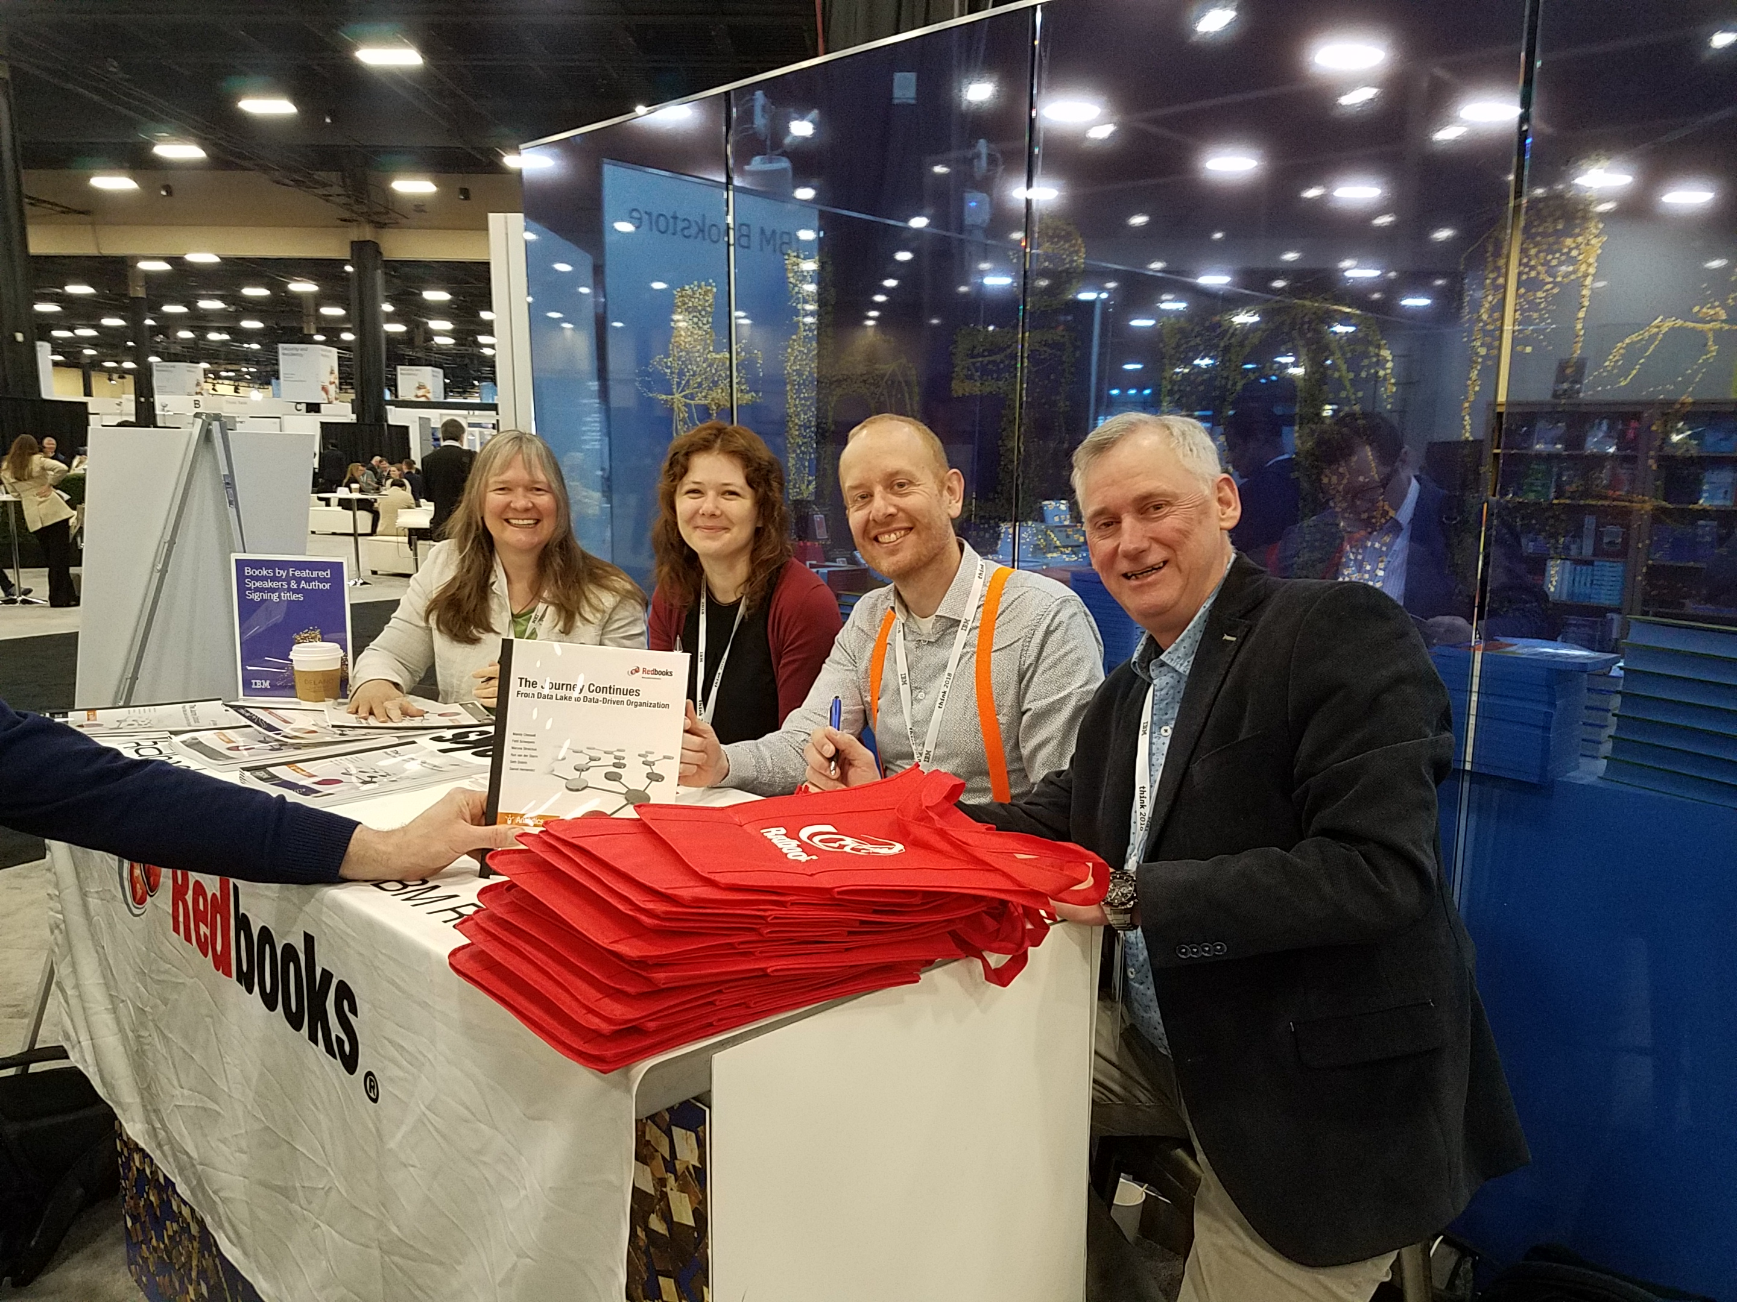
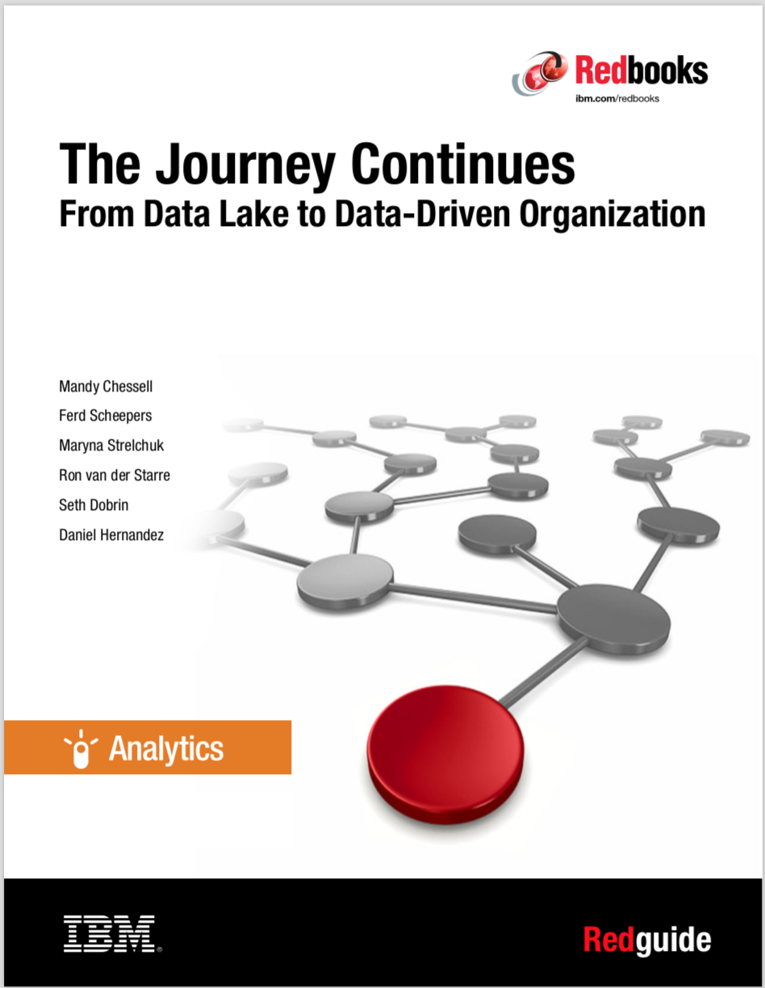
The Journey Continues …
http://www.redbooks.ibm.com/abstracts/redp5486.html?Open
https://www.youtube.com/watch?v=LMmm74t-BBA

Slide 3
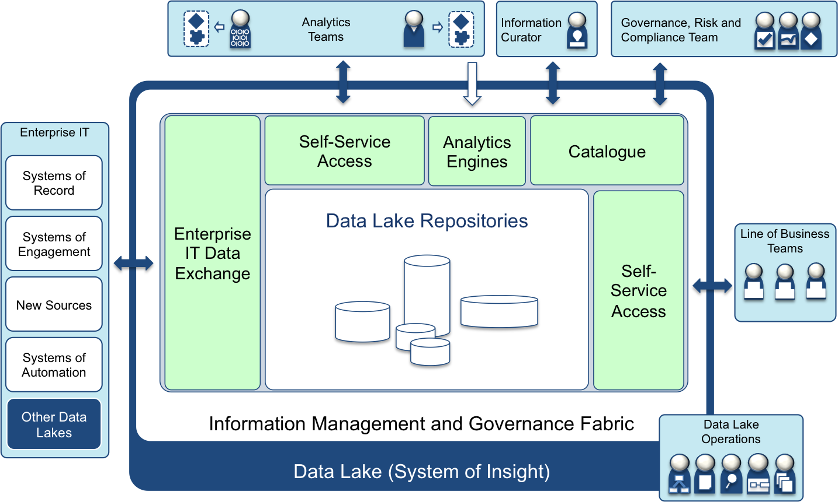
Considerations for a well-managed and governed data lake
Curation of all data to define meaning and classifications
6
9
5
Business-led information governance and management
Access to raw data to develop new production analytics.
4
2
Effective interchange of data and insight with other systems.
Catalog of data, ownership, meaning and permitted usage
10
Moderated, view-based self-service access to data and analytics for line of business.
No direct access to repositories
3
7
1
Multiple repositories organized based on source and usage; hosted on appropriate data platforms for workload.
Data-centric Security
Active monitoring and management of data
8

Slide 4
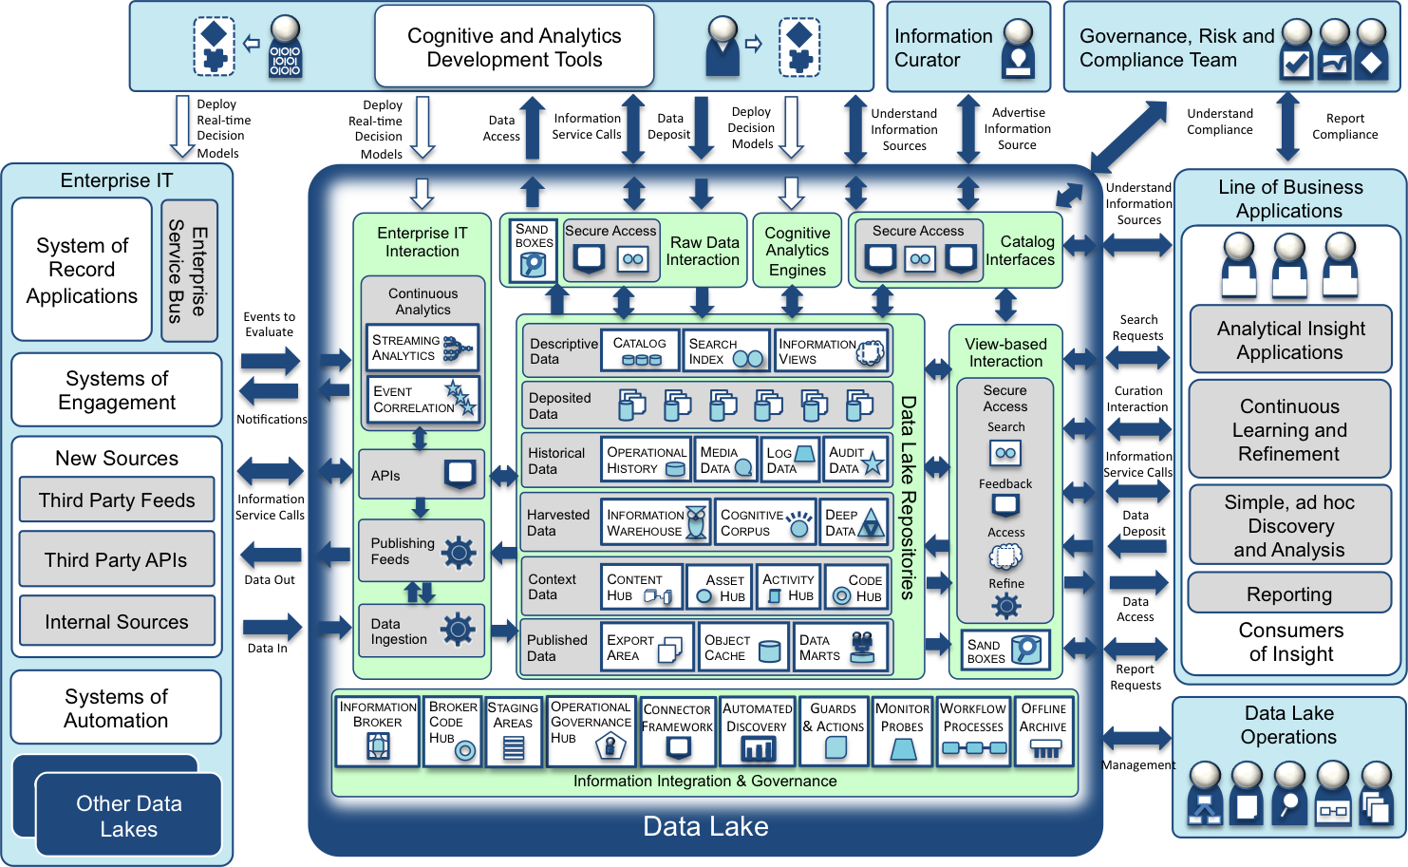
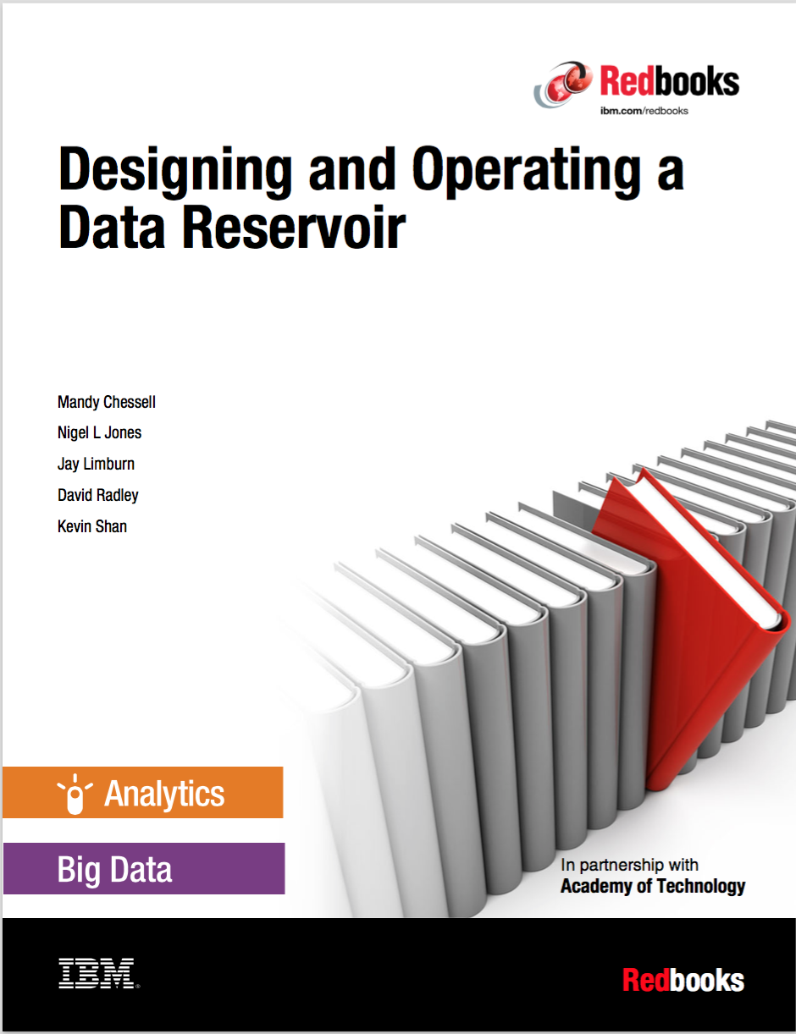
Data Lake – expanding the scope of data processed
http://www.redbooks.ibm.com/Redbooks.nsf/RedpieceAbstracts/sg248274.html?Open

Slide 5
Egeria architectural principles
Autonomic
Self-configuring
Self-validating
Self-optimizing
Automatable
First-Failure Data Capture
Configuration-defined
Integrate-able
Build on connector framework
Dependency management
Extensible/adaptable
Configuration defined
Dynamic types
Multi-tenant, container compatible
“Fair” ecosystem
Peer-to-peer
Adapting
Value-add integration points
Conformance mark
Trustworthy
Metadata provenance, ownership and integrity
Secure platform
Metadata instance security
Inclusive
Optional support options
Proportionate complexity
Broad applicability
Innovative
Zones
Metadata-driven management of third party technology
Human interaction with metadata ecosystem
Educational
Best-practices
Standards based
Content-rich

Slide 6
Autonomic
Self-configuring
Self-validating
Self-optimizing

Slide 7
ODPi Egeria enables exchange of metadata between tools from different vendors
Development
DevOps
Data Science
Open and
Unified Metadata

Slide 8
Example of a simple cohort
Data Lake
Cohort A
Chief Data Office
Systems of Record

Slide 9
Connecting to multiple cohorts
Data Lake
Marketing
Data Lake
Cohort A
Cohort B
Chief Data Office
Systems of Record
Systems of Record
Mobile
Apps

Slide 10
First server
The first server to join the cohort issues a registration request and waits for others to join.

Slide 11
Establishing contact
When another server joins the cohort they exchange registration information.

Slide 12
Federated queries
Once the registration is complete the cohort members can query each other.

Slide 13
Caching metadata for availability and performance
Metadata can also be replicated through the cohort

Slide 14
Through the Repository Services
{
"class": "EntityDetailResponse",
"relatedHTTPCode": 200,
"entity": {
"class": "EntityDetail",
"type": {
"class": "InstanceType",
"typeDefCategory": "ENTITY_DEF",
"typeDefGUID": "578a3510-9ad3-45fe-8ada-e4e9572c37c8",
"typeDefName": "GovernanceOfficer",
"typeDefVersion": 1,
"typeDefDescription": "Person responsible for a governance domain.",
"typeDefSuperTypes": [
{
"guid": "a32316b8-dc8c-48c5-b12b-71c1b2a080bf",
"name": "Referenceable"
}
],
"validInstanceProperties": [
"qualifiedName",
"additionalProperties",
"title",
"scope",
"domain"
]
},
"createdBy": "julesk",
"createTime": "2018-09-11T13:01:20.139+0000",
"version": 1,
"instanceProvenanceType": "LOCAL_COHORT",
"metadataCollectionId": "87b06ffe-9db2-4ef5-ba6e-8127480cf30d",
"guid": "fd7d41e7-70f5-42ec-86d3-88683e599494",
"instanceURL": "http://localhost:8080/instances/entity/fd7d41e7-70f5-42ec-86d388683e599494",
"properties": {
"class": "InstanceProperties",
"instanceProperties": {
"title": {
"class": "PrimitivePropertyValue",
"instancePropertyCategory": "PRIMITIVE",
"primitiveDefCategory": "OM_PRIMITIVE_TYPE_STRING",
"primitiveValue": "Chief Data Officer (CDO)"
},
"qualifiedName": {
"class": "PrimitivePropertyValue",
"instancePropertyCategory": "PRIMITIVE",
"primitiveDefCategory": "OM_PRIMITIVE_TYPE_STRING",
"primitiveValue": "EXEC-CDO"
},
"domain": {
"class": "EnumPropertyValue",
"instancePropertyCategory": "ENUM",
"ordinal": 1,
"symbolicName": "Data",
"description": "The data (information) governance domain."
}
},
"propertyNames": [
"qualifiedName",
"domain",
"title"
],
"propertyCount": 3
},
"status": "ACTIVE"
}
}
http://localhost:8080/open-metadata/repository-services/users/julesk/instances/entity/fd7d41e7-70f5-42ec-86d3-88683e599494
Type
Control
Properties

Slide 15
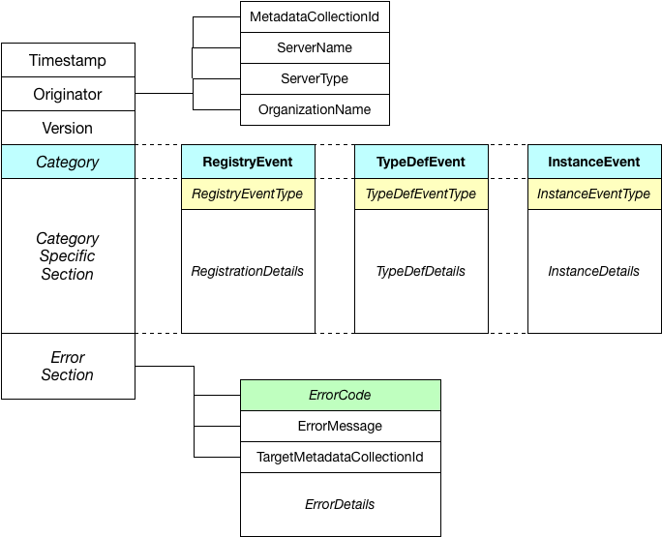
Event design

Slide 16
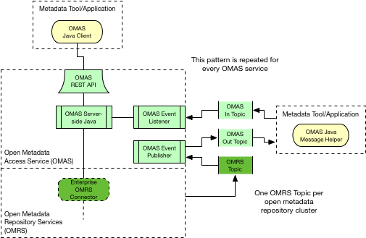
OMAS Anatomy

Slide 17
Automatable
First-Failure Data Capture
Configuration-defined

Slide 18
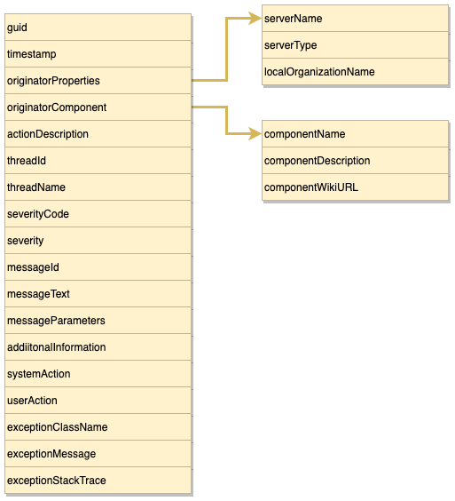
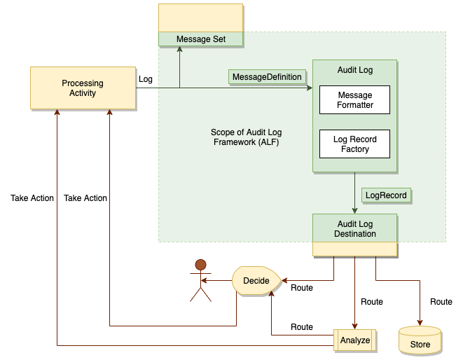
Audit Log Framework (ALF)

Slide 19
Open Metadata and Governance (ODPi Egeria)
Open APIs for tools and engines
Metadata
Repository
Metadata
Repository
Data Tools
Security Tools
Open Metadata Highway
Open metadata exchange and federated queries

Slide 20


Automating governance example
Define Policies
Build
Analytics
Control Data Use
IBM
Information
Governance
Catalog
Apache Atlas
Gaian
Data Virtualization
Apache Ranger
Manage Data Access
Open Metadata Highway

Slide 21
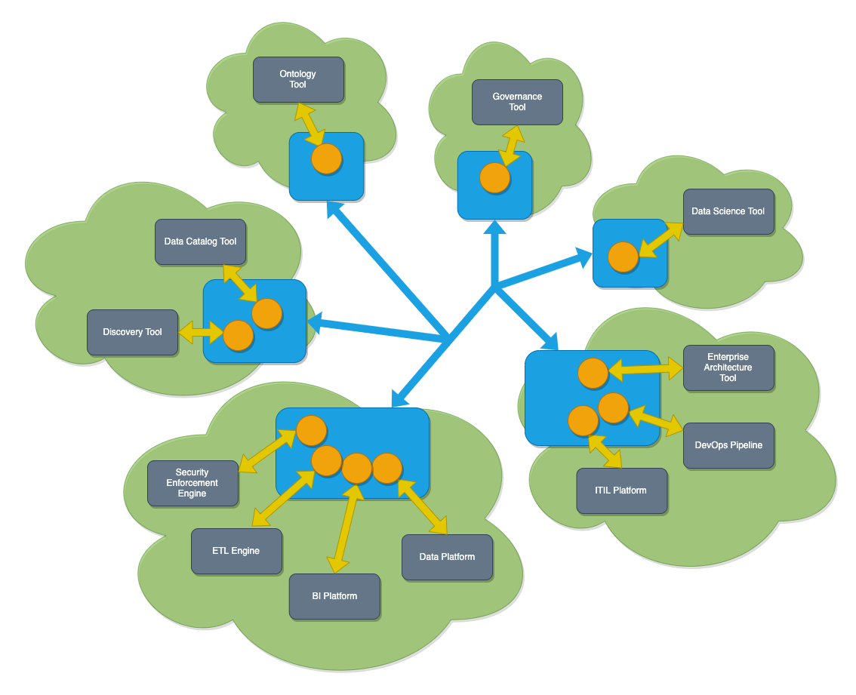
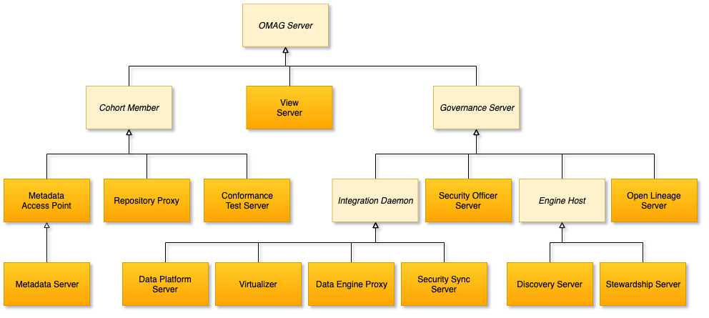
Types of OMAG Servers

Slide 22
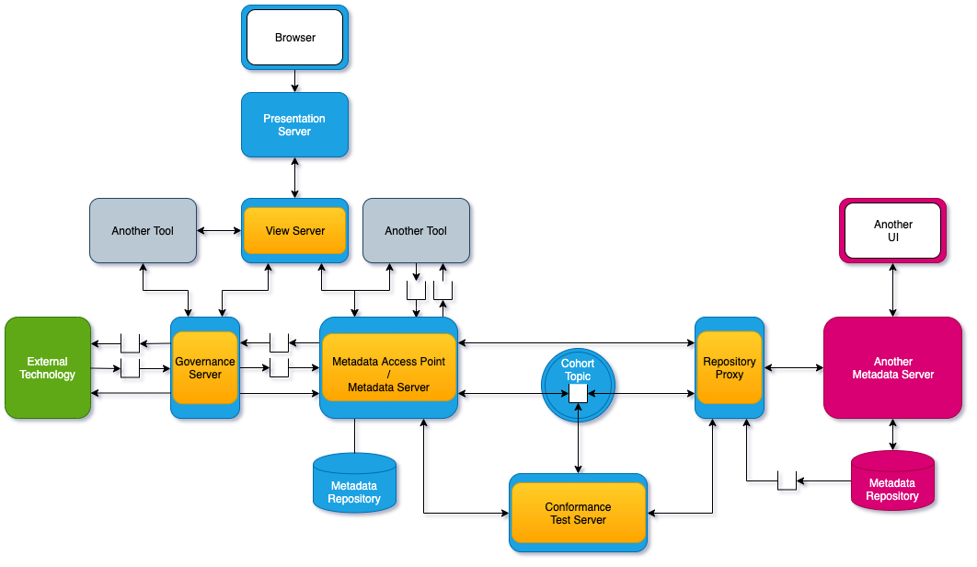
Connected OMAG Servers

Slide 23
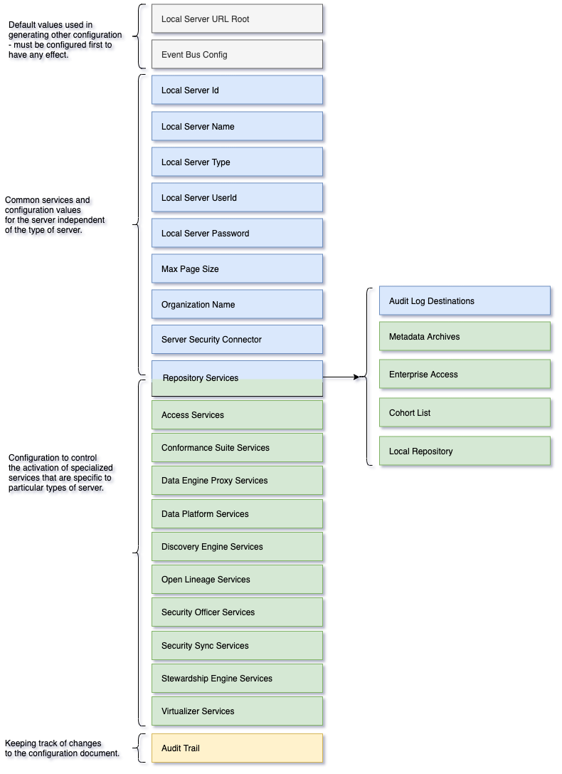
Configuration Document

Slide 24



Event-driven governance
Assign
Owner
New
Database
Open
Metadata
Classify
Data
Use
Data

Slide 25
Integrate-able
Build on connector framework
Dependency management

Slide 26
Open Connector Framework (OCF)
Intercept point

Slide 27
Example of a simple cohort
Data Lake
Cohort A
Chief Data Office
Systems of Record

Slide 28
IBM Information Governance Catalog Integration
IGC uses the Adapter Pattern
There are two connectors to IGC in the repository proxy server.
They translate IGC APIs and events into open metadata APIs and events.
Egeria handles the interaction with the cohort.
Repository Proxy
Information
Governance
Catalog
ODPi Egeria
Repository Connector
Event Mapper Connector
Open Metadata Highway

Slide 29
Apache Atlas Integration
Apache Atlas uses the Native Pattern
There are two connectors to Apache Atlas that translate Atlas APIs and events into open metadata APIs and events.
ODPi Egeria handles the interaction with the cohort.
The connectors and the ODPi Egeria libraries reside in the Atlas server
ODPi Egeria
Apache
Atlas
Repository Connector
Event Mapper Connector
Open Metadata Highway

Slide 30
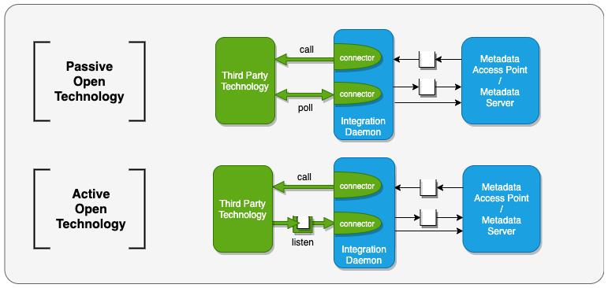
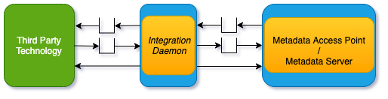
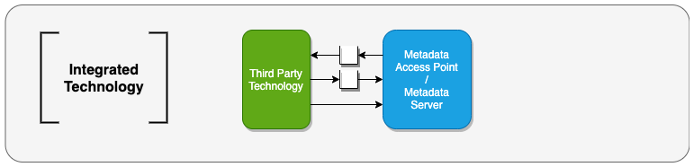
Integration Daemons

Slide 31
A hybrid multi-cloud world
Independent metadata Repository
New applications deployed to cloud
Mobile Apps
IoT devices and
systems
Business Partners
Sharing data
Linked metadata Repositories
Data Lake
Applications
Databases
Files
Applications

Slide 32
Open metadata ecosystem
Independent metadata Repository
New applications deployed to cloud
Mobile Apps
IoT devices and
systems
Business Partners
Sharing data
Linked metadata Repositories
Data Lake
Applications
Databases
Files
Applications

Slide 33
Egeria in operation
Egeria’s platform (in blue) runs in each deployment environment (cloud or on premises)
Egeria servers (orange circles) are deployed on the platform. Each are specialized to support the metadata needs of specific technologies
Egeria manages the exchange of metadata between all parties.

Slide 34
Extensible/Adaptable
Configuration defined
Dynamic types
Multi-tenant, container compatible

Slide 35
The OMAG Server Platform
OMAG Server Platform
OMAG Server Platform
OMAG Server Platform
OMAG Server Platform
OMAG Server Platform
Multi-tenant
Egeria Server 1
Egeria Server 1
Egeria Server 2
Egeria Server 2
Egeria Server 3
Egeria Server 3
OMAG Server Platform
Egeria Server 1
Edge
Kubernetes

Slide 36
Scope of metadata covered
Governance
Glossary
Collaboration
Models and
Reference Data
Lineage
Metadata
Discovery
Data Assets
Base Types, Systems
and Infrastructure

Slide 37
Scope of metadata covered
Strategy
4
Subject Area Definition
1
Teaming Metadata
(people profiles, communities, projects,
notebooks, …)
Policy Metadata (Principles, Regulations, Standards, Approaches, Rule Specifications, Roles and Metrics)
Business Objects and Relationships, Taxonomies and Ontologies
Augmentation
3
Organization
Feedback Metadata
(tags, comments, ratings, …)
Rollout
Classification
Business Attributes
Campaigns and Projects
Classification Schemes
Implementation
Mapping
Governance Actions and Processes
Rights
Management
Models and Schemas
2
Asset Collections
(Sets, Typed Sets, Type Organized Sets)
Reference Data
5
Instrument
7
Information Process
Instrumentation (design lineage)
Association
Information Views
Augmentation
Discovery
Metadata (profile data, technical classification, data classification,
data quality assessment, …)
Physical Asset Descriptions
(Data stores, APIs,
models and components)
0
Basic Types, Infrastructure and Systems
Access
6
Connectors

Slide 38
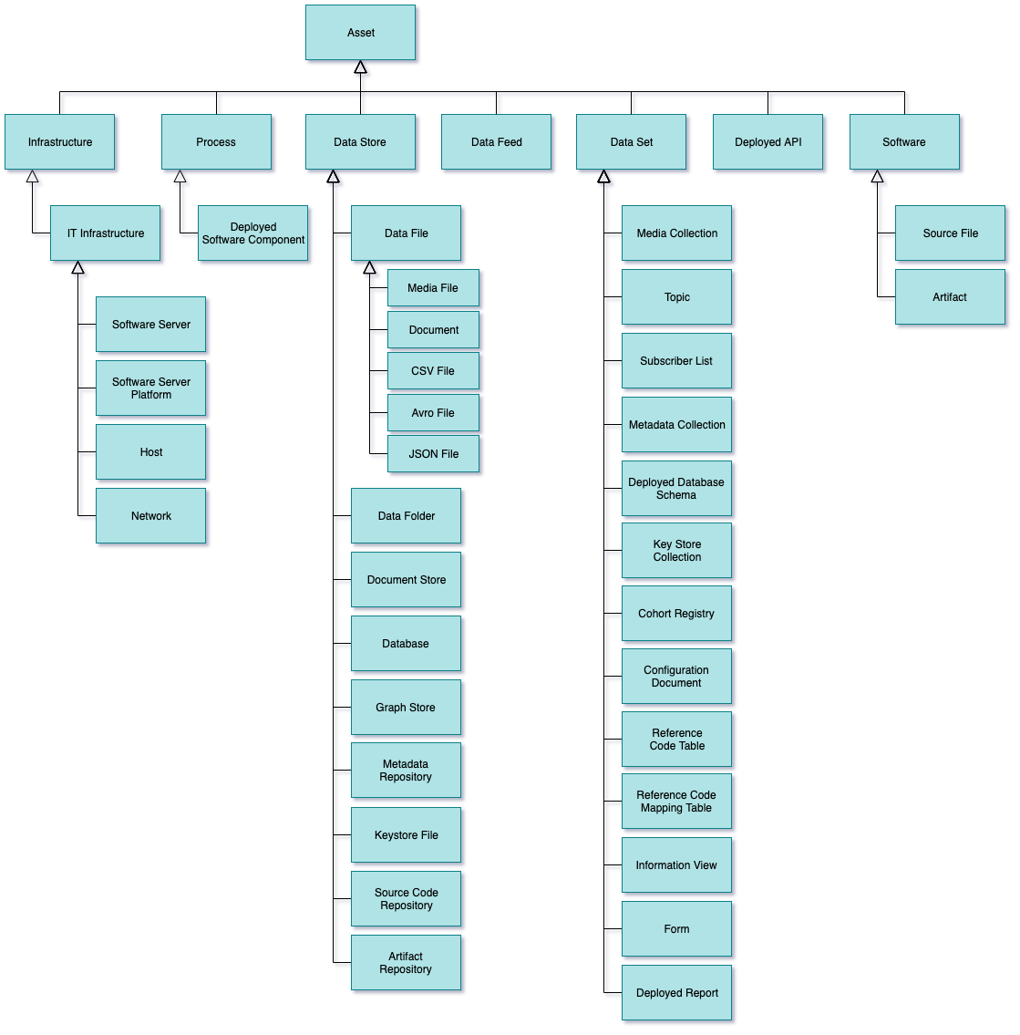
Types of Asset
Infrastructure – hardware and software generic “platforms”.
Process – well defined sequence of actions.
DataStore – data at rest
DataFeed - data in motion
DataSet – collection of data
DeployedAPI – interface
Software – parts for IT system

Slide 39
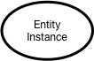
Instance representations in the repository services

Slide 40
Importance of the distributed graph model
Database
Column
Glossary Term
Server 1
Server 2
Entity
Entity

Slide 41
Importance of the distributed graph model
Database
Column
Glossary Term
Glossary
Term
Meaning
Server 1
Server 2
Reference
Copy
Relationship

Slide 42
Importance of the distributed graph model
Database
Column
Glossary
Term
Server 1
Server 2
Database Column
Glossary
Term
Meaning
Server 3

Slide 43
Importance of the distributed graph model
Database
Column
Glossary
Term
Server 1
Server 2
Entity
Proxy
Database
Column
Glossary
Term
Meaning
Server 3

Slide 44
Fair Ecosystem
Peer-to-peer
Adapting
Value-add integration points
Conformance mark

Slide 45
Characteristics of successful ecosystems (AoT 2007)
Equity within the ecosystem – mutual benefit being derived by all participants
Active engagement from all participants, focused towards a common goal and based on trust
Intellectual Property (IP) policy and other intellectual capital ownership issues negotiated and agreed from the inception of the ecosystem
Adequate resources to deliver on promises
The correct mix of skills to cover all aspects of the ecosystem’s mission

Slide 46
A new manifesto for metadata and governance
The maintenance of metadata must be automated to scale to the sheer volumes and variety of data involved in modern business. Similarly the use of metadata should be used to drive the governance of data and create a business friendly logical interface to the data landscape.
The availability of metadata management must become ubiquitous in cloud platforms and large data platforms, such as Apache Hadoop so that the processing engines on these platforms can rely on its availability and build capability around it.
Metadata access must become open and remotely accessible so that tools from different vendors can work with metadata located on different platforms. This implies unique identifiers for metadata elements, some level of standardization in the types and formats for metadata and standard interfaces for manipulating metadata.
Wherever possible, discovery and maintenance of metadata has to an integral part of all tools that access, change and move information.

Slide 47
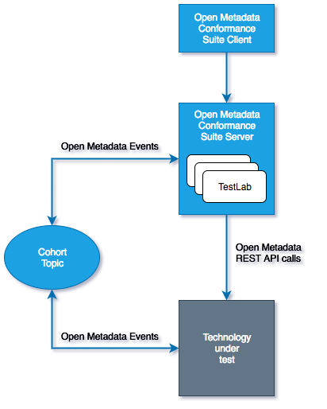
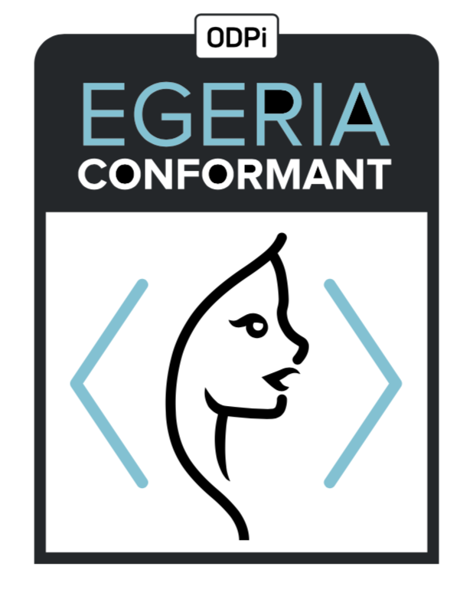
Egeria Conformance Program - its an “imitation game”
Workbench
Vendors that pass the conformance suite can display this mark
Notes:
ODPi

Slide 48
Trustworthy
Metadata provenance, ownership and integrity
Secure platform
Metadata instance security

Slide 49
Through the Repository Services
{
"class": "EntityDetailResponse",
"relatedHTTPCode": 200,
"entity": {
"class": "EntityDetail",
"type": {
"class": "InstanceType",
"typeDefCategory": "ENTITY_DEF",
"typeDefGUID": "578a3510-9ad3-45fe-8ada-e4e9572c37c8",
"typeDefName": "GovernanceOfficer",
"typeDefVersion": 1,
"typeDefDescription": "Person responsible for a governance domain.",
"typeDefSuperTypes": [
{
"guid": "a32316b8-dc8c-48c5-b12b-71c1b2a080bf",
"name": "Referenceable"
}
],
"validInstanceProperties": [
"qualifiedName",
"additionalProperties",
"title",
"scope",
"domain"
]
},
"createdBy": "julesk",
"createTime": "2018-09-11T13:01:20.139+0000",
"version": 1,
"instanceProvenanceType": "LOCAL_COHORT",
"metadataCollectionId": "87b06ffe-9db2-4ef5-ba6e-8127480cf30d",
"guid": "fd7d41e7-70f5-42ec-86d3-88683e599494",
"instanceURL": "http://localhost:8080/instances/entity/fd7d41e7-70f5-42ec-86d388683e599494",
"properties": {
"class": "InstanceProperties",
"instanceProperties": {
"title": {
"class": "PrimitivePropertyValue",
"instancePropertyCategory": "PRIMITIVE",
"primitiveDefCategory": "OM_PRIMITIVE_TYPE_STRING",
"primitiveValue": "Chief Data Officer (CDO)"
},
"qualifiedName": {
"class": "PrimitivePropertyValue",
"instancePropertyCategory": "PRIMITIVE",
"primitiveDefCategory": "OM_PRIMITIVE_TYPE_STRING",
"primitiveValue": "EXEC-CDO"
},
"domain": {
"class": "EnumPropertyValue",
"instancePropertyCategory": "ENUM",
"ordinal": 1,
"symbolicName": "Data",
"description": "The data (information) governance domain."
}
},
"propertyNames": [
"qualifiedName",
"domain",
"title"
],
"propertyCount": 3
},
"status": "ACTIVE"
}
}
http://localhost:8080/open-metadata/repository-services/users/julesk/instances/entity/fd7d41e7-70f5-42ec-86d3-88683e599494
Type
Control
Properties

Slide 50
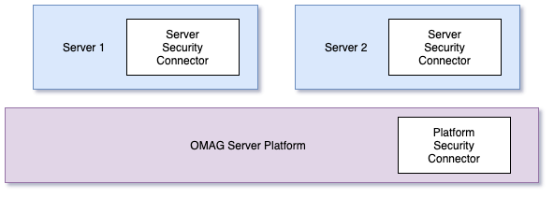
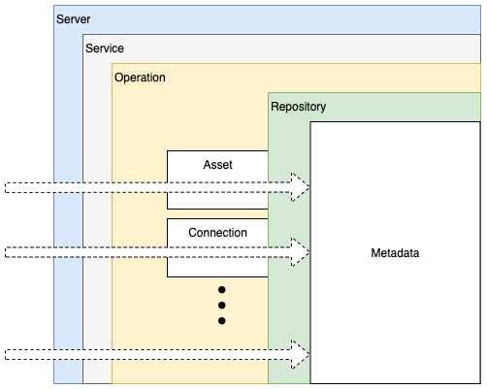
Metadata security

Slide 51
Inclusive
Optional support options
Proportionate complexity
Broad applicability

Slide 52
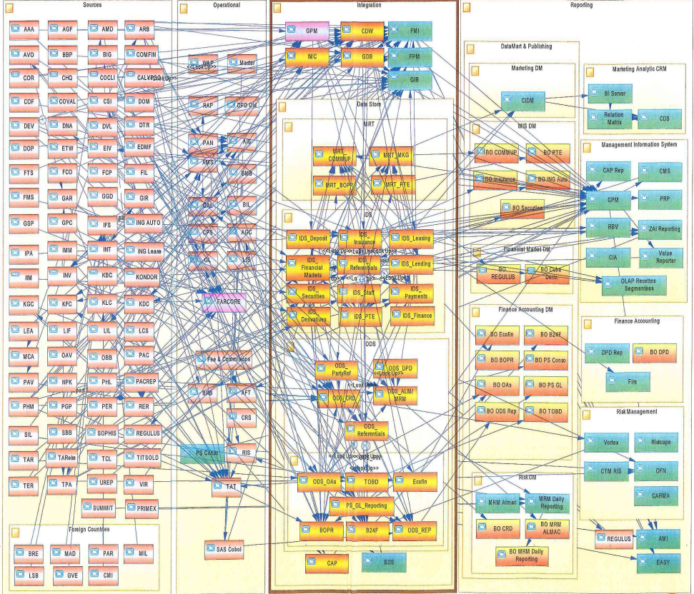
Real Data Landscapes
Complexity is biggest challenge in IT today
Many enterprises have had 40 years of innovation embedded into their IT Systems.
With data moving rapidly between systems, how can a data scientist be sure that they understand the meaning, accuracy, timeliness and precision of any data that they receive?

Slide 53





The data driven organization …
Collaborating across all 3 lifecycles
Governance Teams
Policy
Policy
Audit
Define
Asset Owners
Enterprise Architecture
Monitor
Policy
Roll out
Classify
Operations
Policy
Metadata
Development
Stewards
Design
Execute
Business Users
Deploy
Developers
Detect
Remediate
Develop
Data Scientists
DevOps

Slide 54
Design philosophy
Use cases,
Personas,
Practitioners
input
Search
Open Metadata Access Services
Open Metadata Repository Services
Data integration, availability and integrity best practices

Slide 55
Through the Repository Services
{
"class": "EntityDetailResponse",
"relatedHTTPCode": 200,
"entity": {
"class": "EntityDetail",
"type": {
"class": "InstanceType",
"typeDefCategory": "ENTITY_DEF",
"typeDefGUID": "578a3510-9ad3-45fe-8ada-e4e9572c37c8",
"typeDefName": "GovernanceOfficer",
"typeDefVersion": 1,
"typeDefDescription": "Person responsible for a governance domain.",
"typeDefSuperTypes": [
{
"guid": "a32316b8-dc8c-48c5-b12b-71c1b2a080bf",
"name": "Referenceable"
}
],
"validInstanceProperties": [
"qualifiedName",
"additionalProperties",
"title",
"scope",
"domain"
]
},
"createdBy": "julesk",
"createTime": "2018-09-11T13:01:20.139+0000",
"version": 1,
"instanceProvenanceType": "LOCAL_COHORT",
"metadataCollectionId": "87b06ffe-9db2-4ef5-ba6e-8127480cf30d",
"guid": "fd7d41e7-70f5-42ec-86d3-88683e599494",
"instanceURL": "http://localhost:8080/instances/entity/fd7d41e7-70f5-42ec-86d388683e599494",
"properties": {
"class": "InstanceProperties",
"instanceProperties": {
"title": {
"class": "PrimitivePropertyValue",
"instancePropertyCategory": "PRIMITIVE",
"primitiveDefCategory": "OM_PRIMITIVE_TYPE_STRING",
"primitiveValue": "Chief Data Officer (CDO)"
},
"qualifiedName": {
"class": "PrimitivePropertyValue",
"instancePropertyCategory": "PRIMITIVE",
"primitiveDefCategory": "OM_PRIMITIVE_TYPE_STRING",
"primitiveValue": "EXEC-CDO"
},
"domain": {
"class": "EnumPropertyValue",
"instancePropertyCategory": "ENUM",
"ordinal": 1,
"symbolicName": "Data",
"description": "The data (information) governance domain."
}
},
"propertyNames": [
"qualifiedName",
"domain",
"title"
],
"propertyCount": 3
},
"status": "ACTIVE"
}
}
http://localhost:8080/open-metadata/repository-services/users/julesk/instances/entity/fd7d41e7-70f5-42ec-86d3-88683e599494
Type
Control
Properties

Slide 56
Through the governance program access service
{
"class": "GovernanceOfficerResponse",
"relatedHTTPCode": 200,
"governanceOfficer": {
"class": "GovernanceOfficer",
"guid": "fd7d41e7-70f5-42ec-86d3-88683e599494",
"type": "GovernanceOfficer",
"title": "Chief Data Officer (CDO)",
"governanceDomain": "DATA",
"appointmentId": "EXEC-CDO",
"appointee": {
"guid": "0760ac98-69e2-4309-ab1d-53377b105d0a",
"type": "GovernancePost",
"profile": {
"guid": "053435b5-b19f-434d-bdd5-f6c909f55cb3",
"type": "Person",
"employeeNumber": "026",
"fullName": "Julian Keeper",
"knownName": "Jules Keeper",
"jobTitle": "Chief Data and Privacy Officer",
"jobRoleDescription": "Ensuring CocoP makes the best use of data.",
"additionalProperties": {
"ContactType": "Employee",
"WorkLocation": 2
}
}
}
}
}
http://localhost:8080/open-metadata/access-services/governance-program/users/julesk/leadership/governance-officers/fd7d41e7-70f5-42ec-86d3-88683e599494
Governance Officer
Governance Post
Person

Slide 57
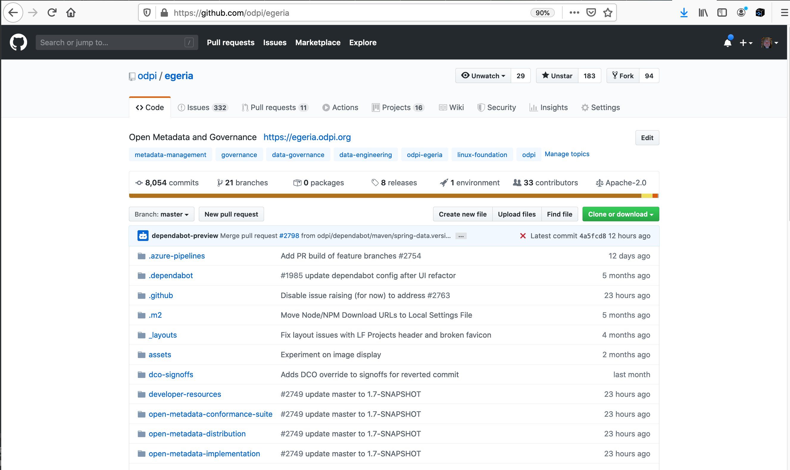
GitHub is the heart of the project
Code repository
Issues
Code Changes
Build
Shop window

Slide 58
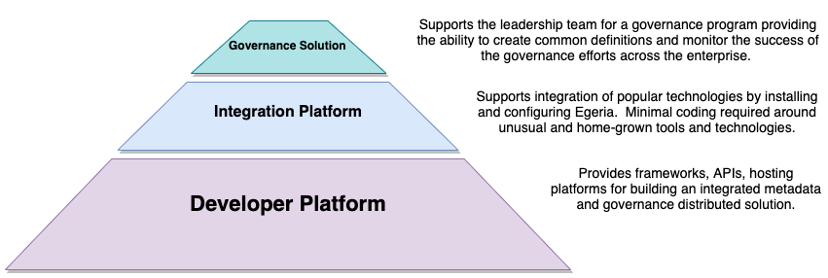
Another way to understand the Egeria capability

Slide 59
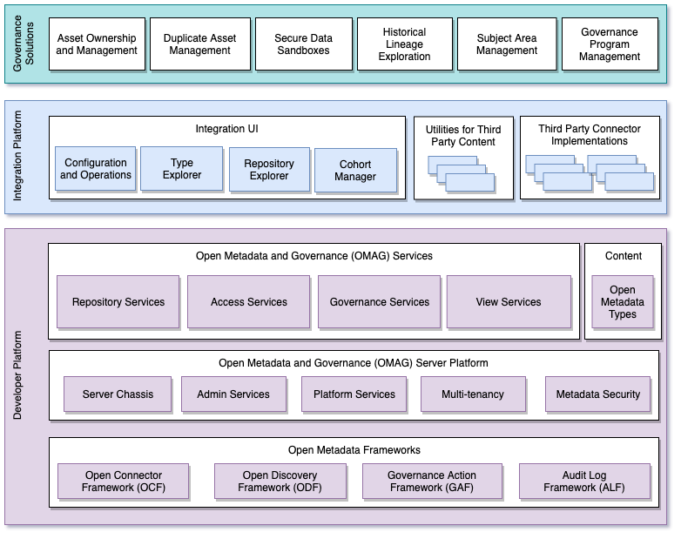
Egeria project structure
Egeria has a modular structure designed for vendors to extend with their value add.
The integration platform and governance solutions exploit the value of the enterprise view provided by the OMAG Services.

Slide 60
Innovative
Governance Zones
Metadata-drive management of third party technology
Human interaction with metadata ecosystem

Slide 61
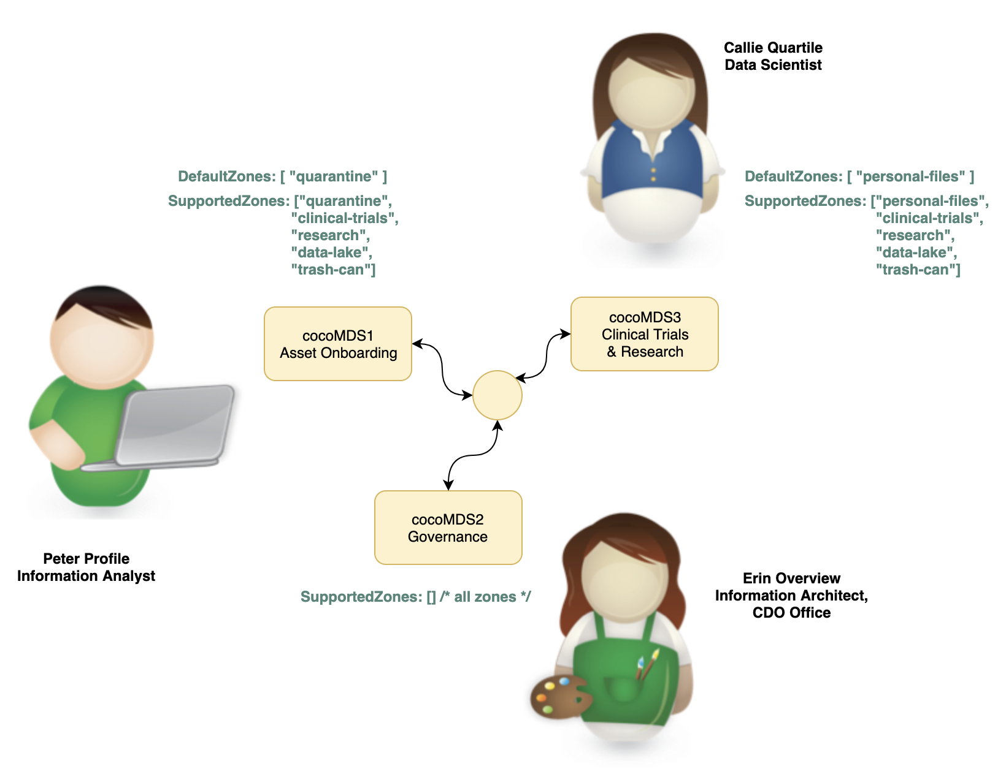
Governance Zones

Slide 62
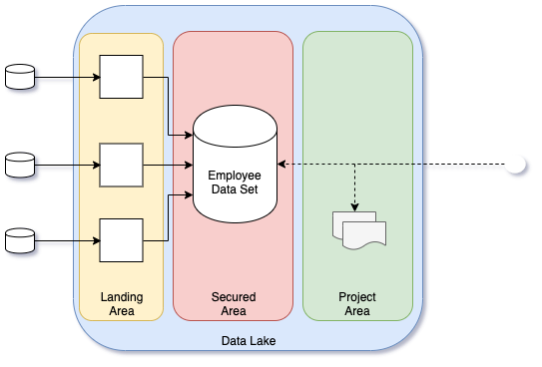

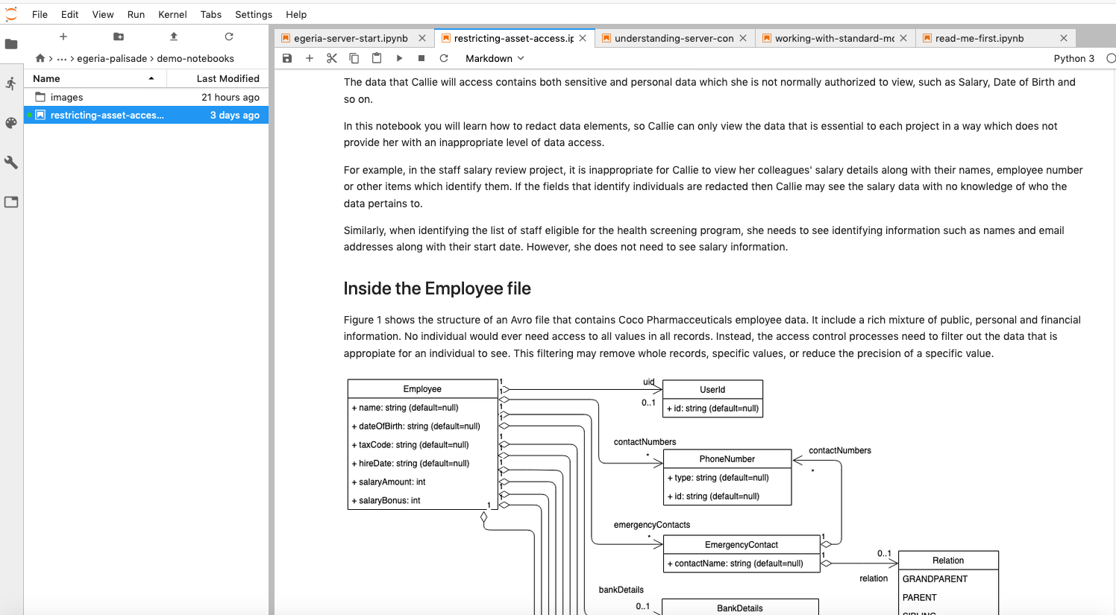
Working with purpose
Palisade allows the use of broader contextual information in the evaluation of a query.
This contextual information combines the user information with additional query time properties.
Query time properties include the origin and purpose of the query
With this approach the application of the access policy to the query considers the broader context of the request.
This means that different subsets of the data are automatically returned when Callie issues a query depending on the context she selects - without the need to duplicate data or configure explicit views.

Slide 63
Coco Pharmaceuticals persona
https://odpi.github.io/data-governance/coco-pharmaceuticals/personas/

Slide 64
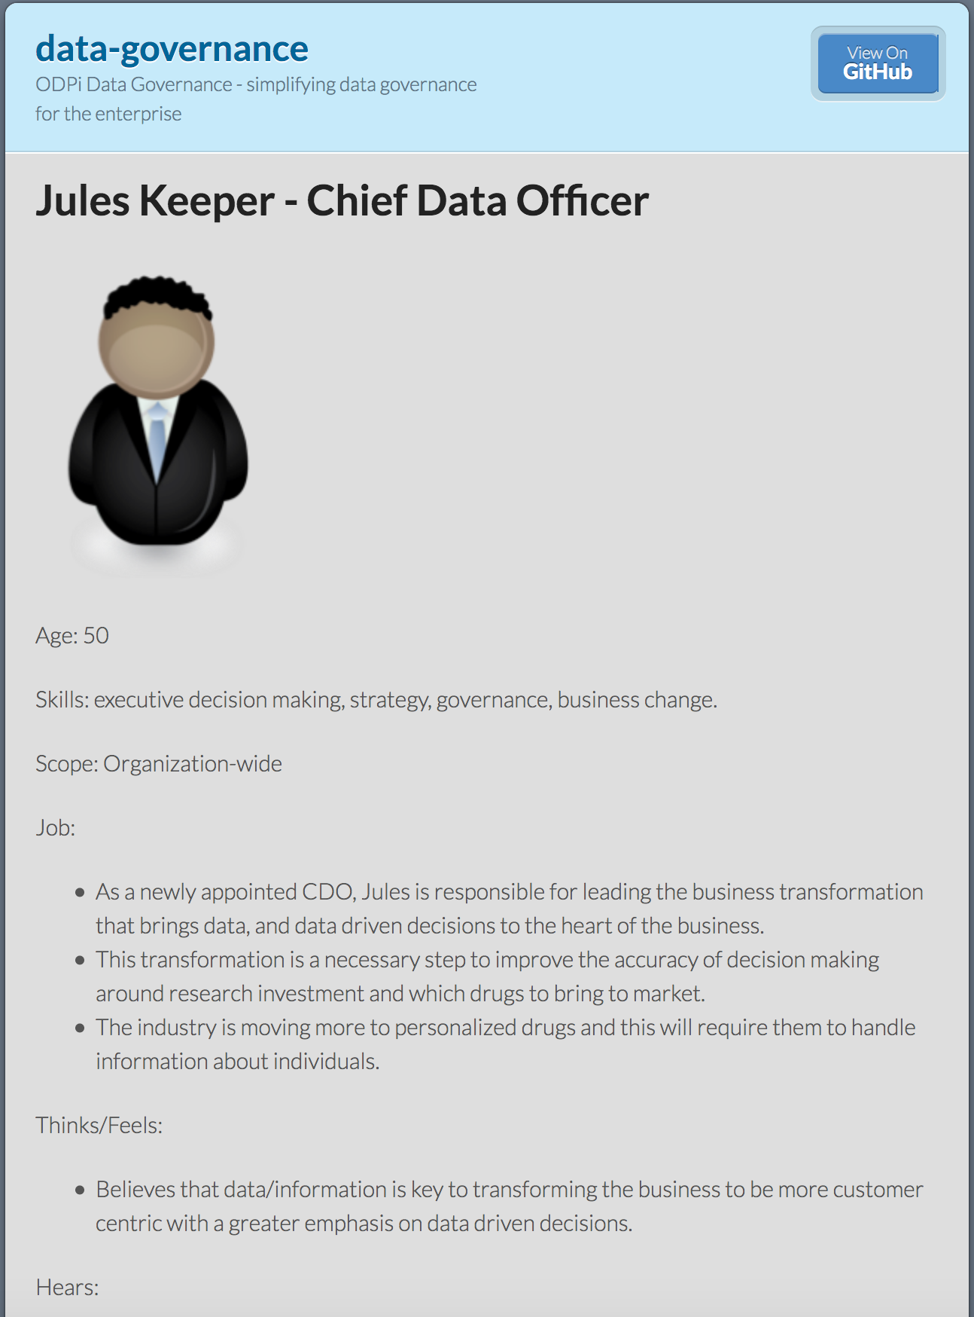
Using design thinking
Open Metadata Types
Access Service Identification
Samples and API design
Best Practices

Slide 65
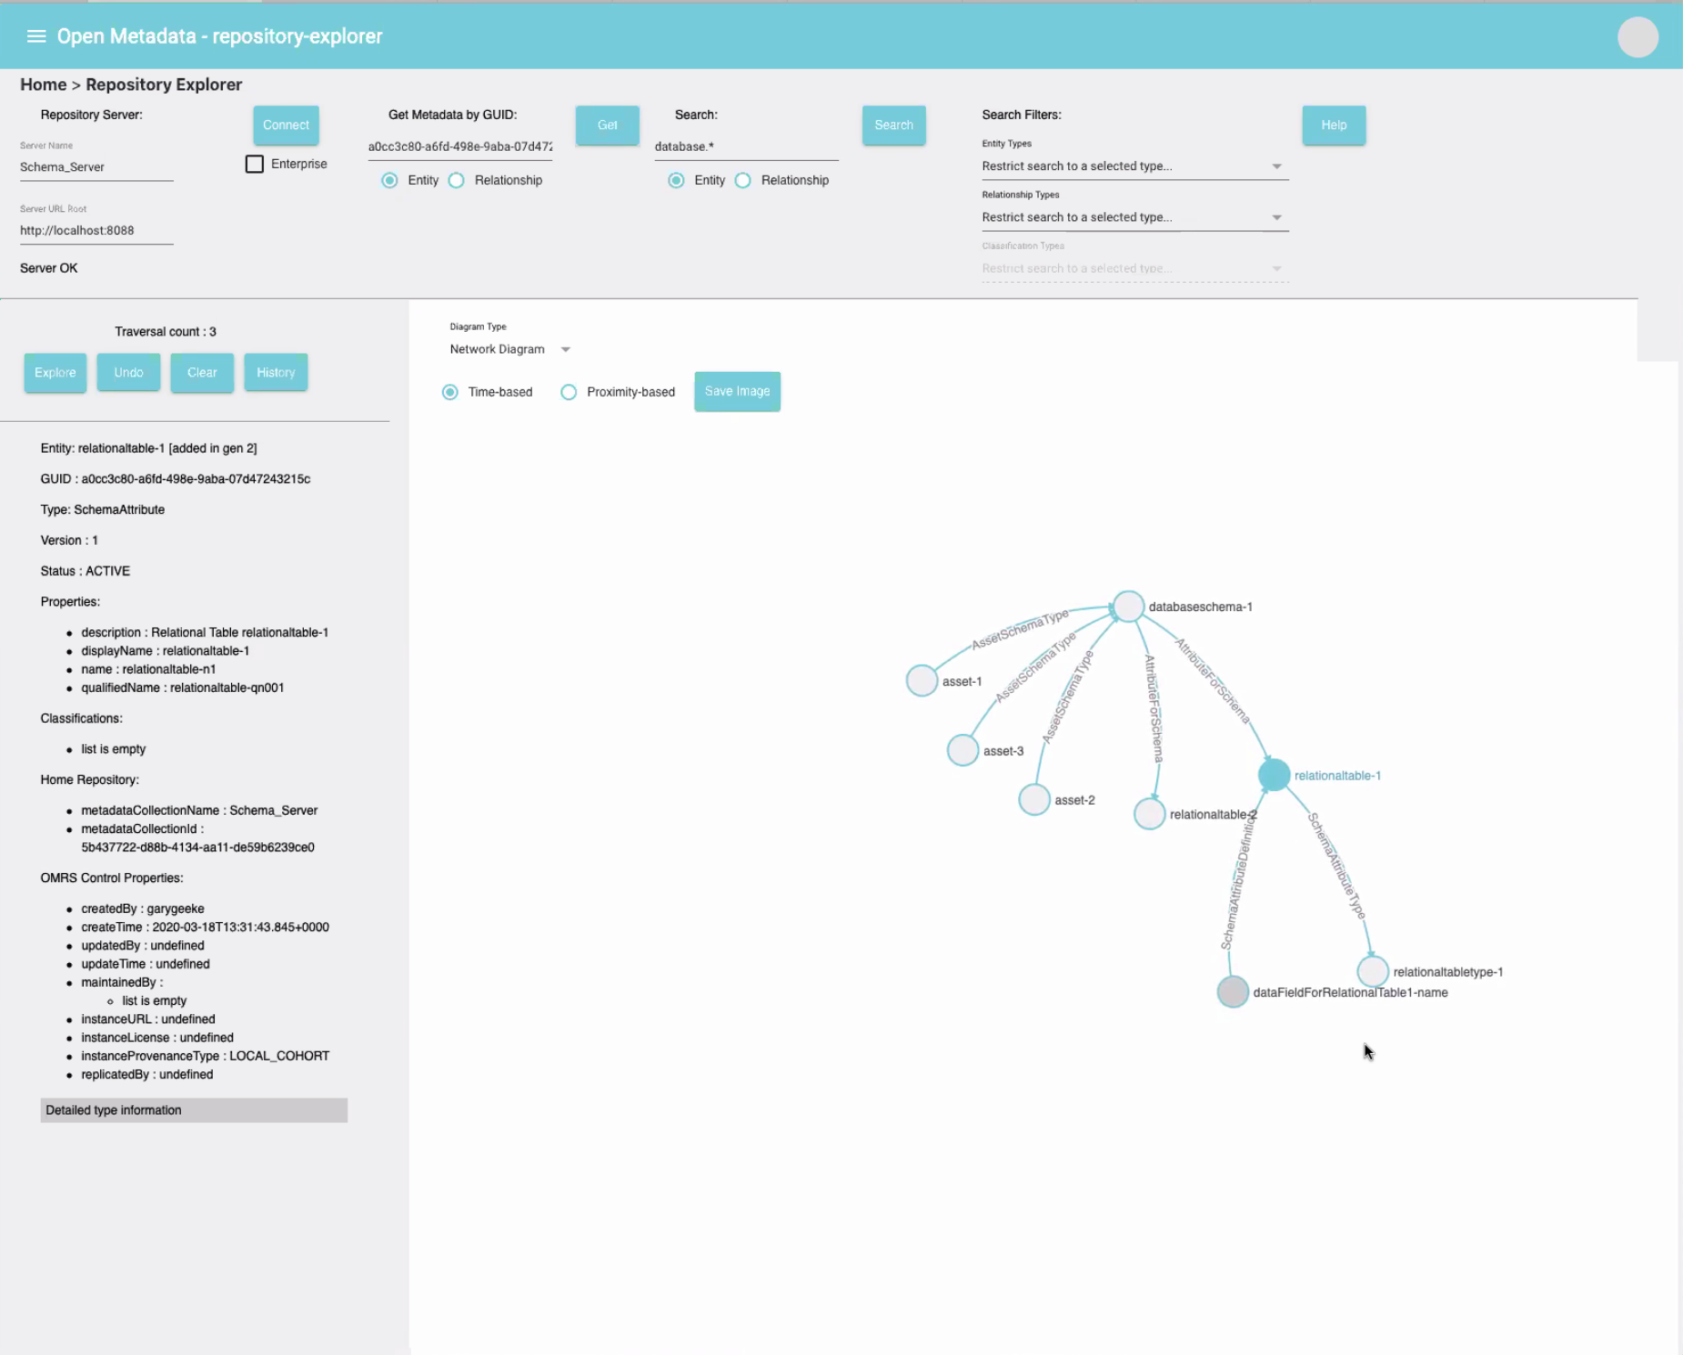
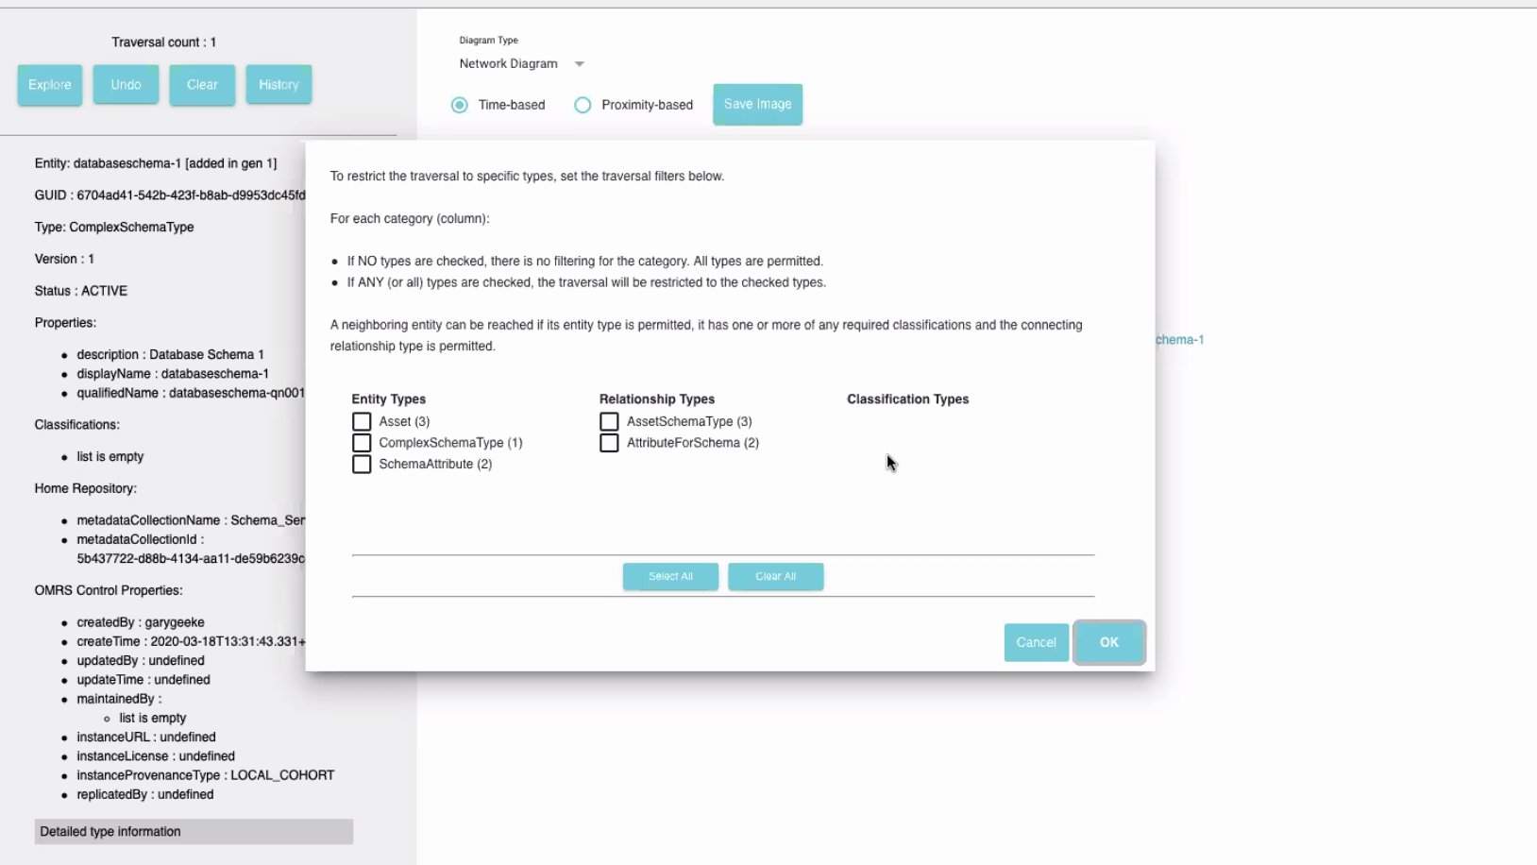
Repository explorer

Slide 66
Educational
Best-practices
Standards based
Content-rich

Slide 67
Types of information
Egeria Dojo
Webinars
Guidance on Governance

Slide 68
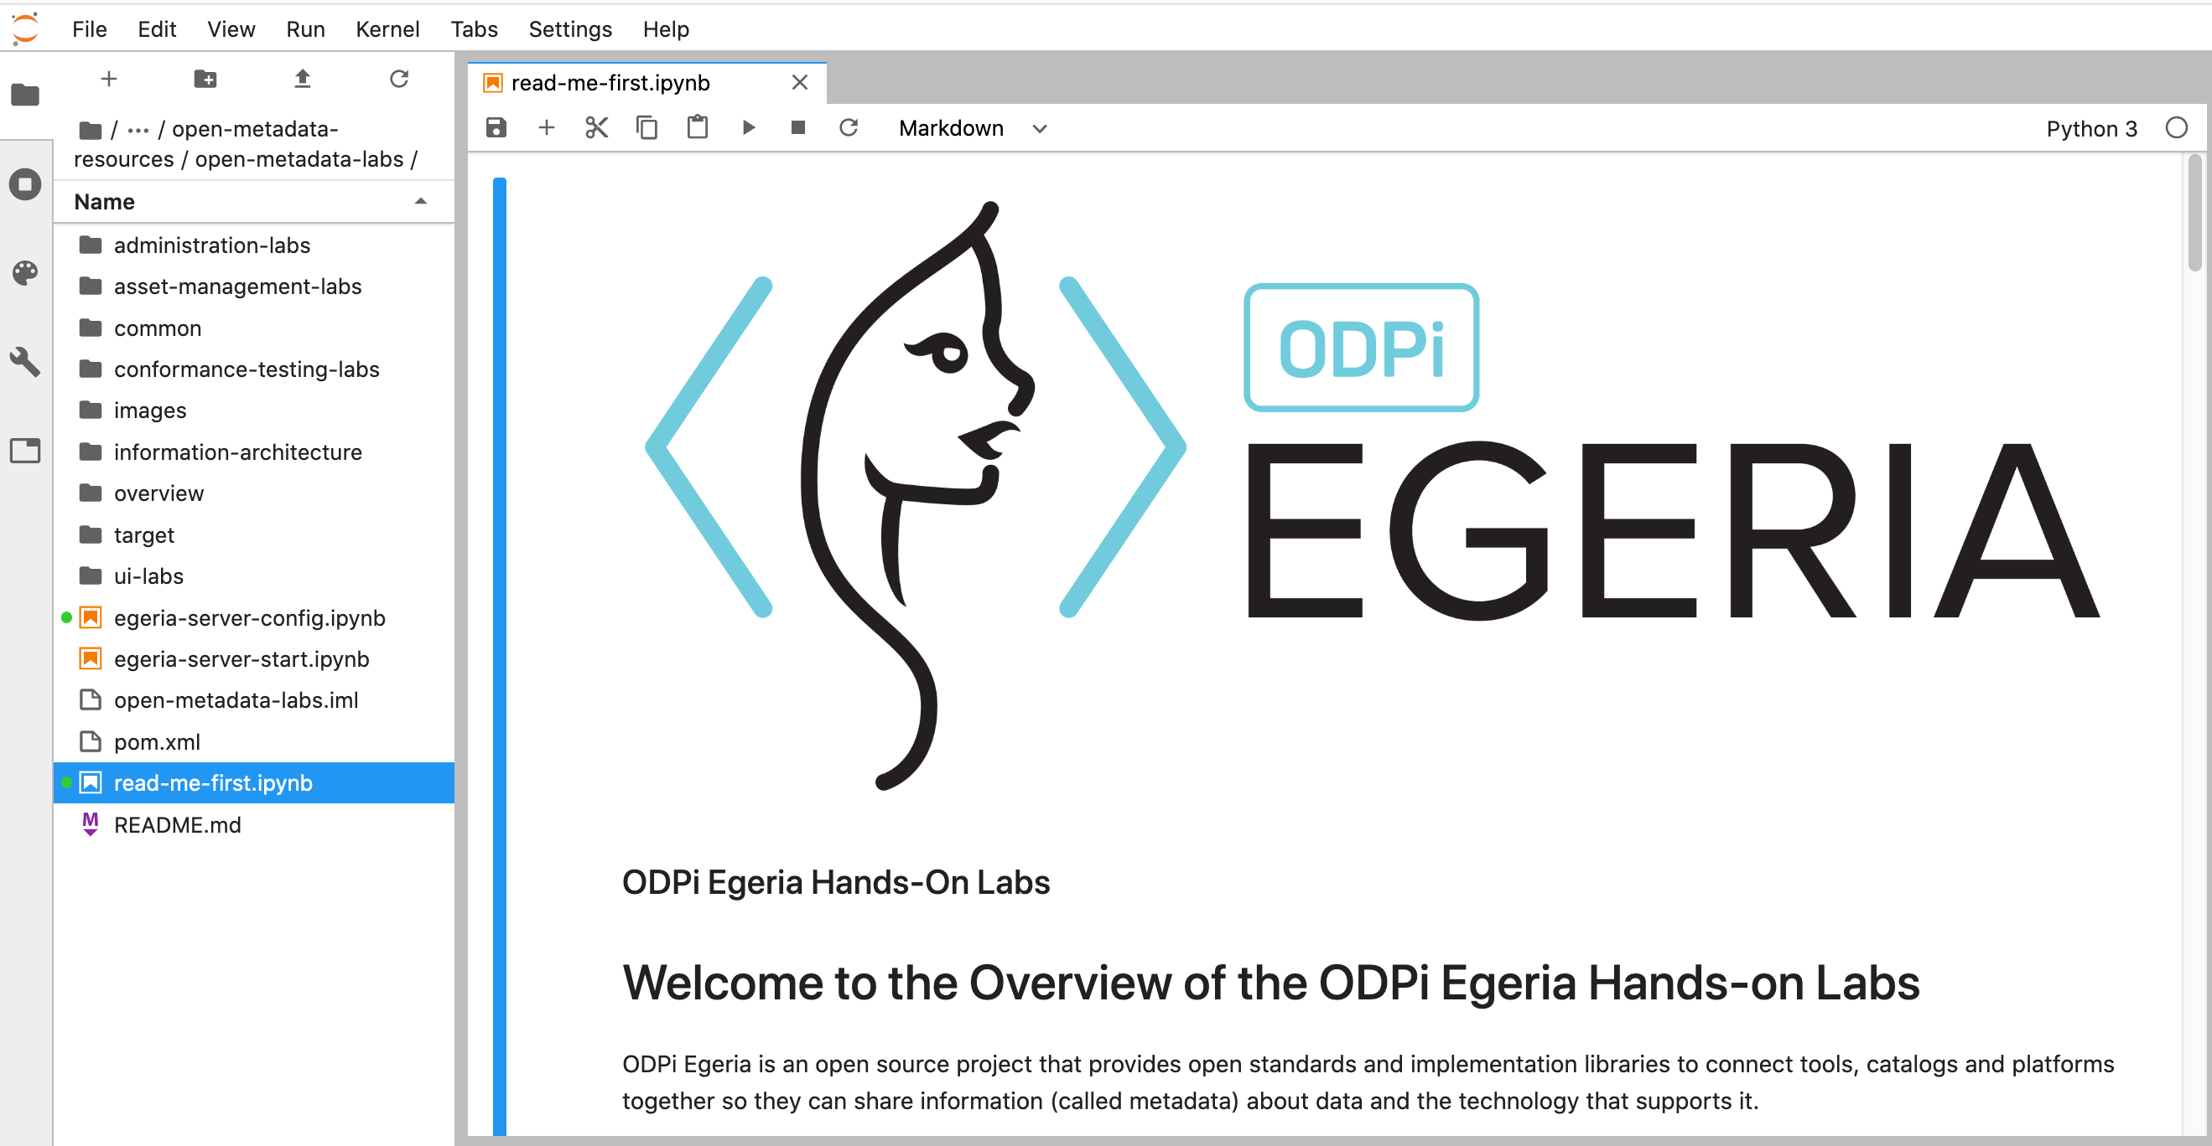
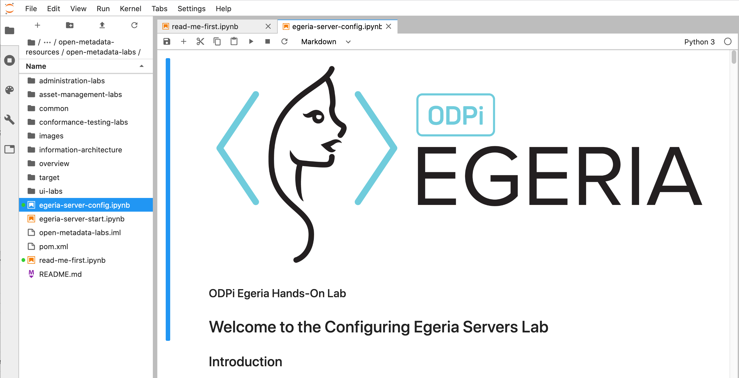
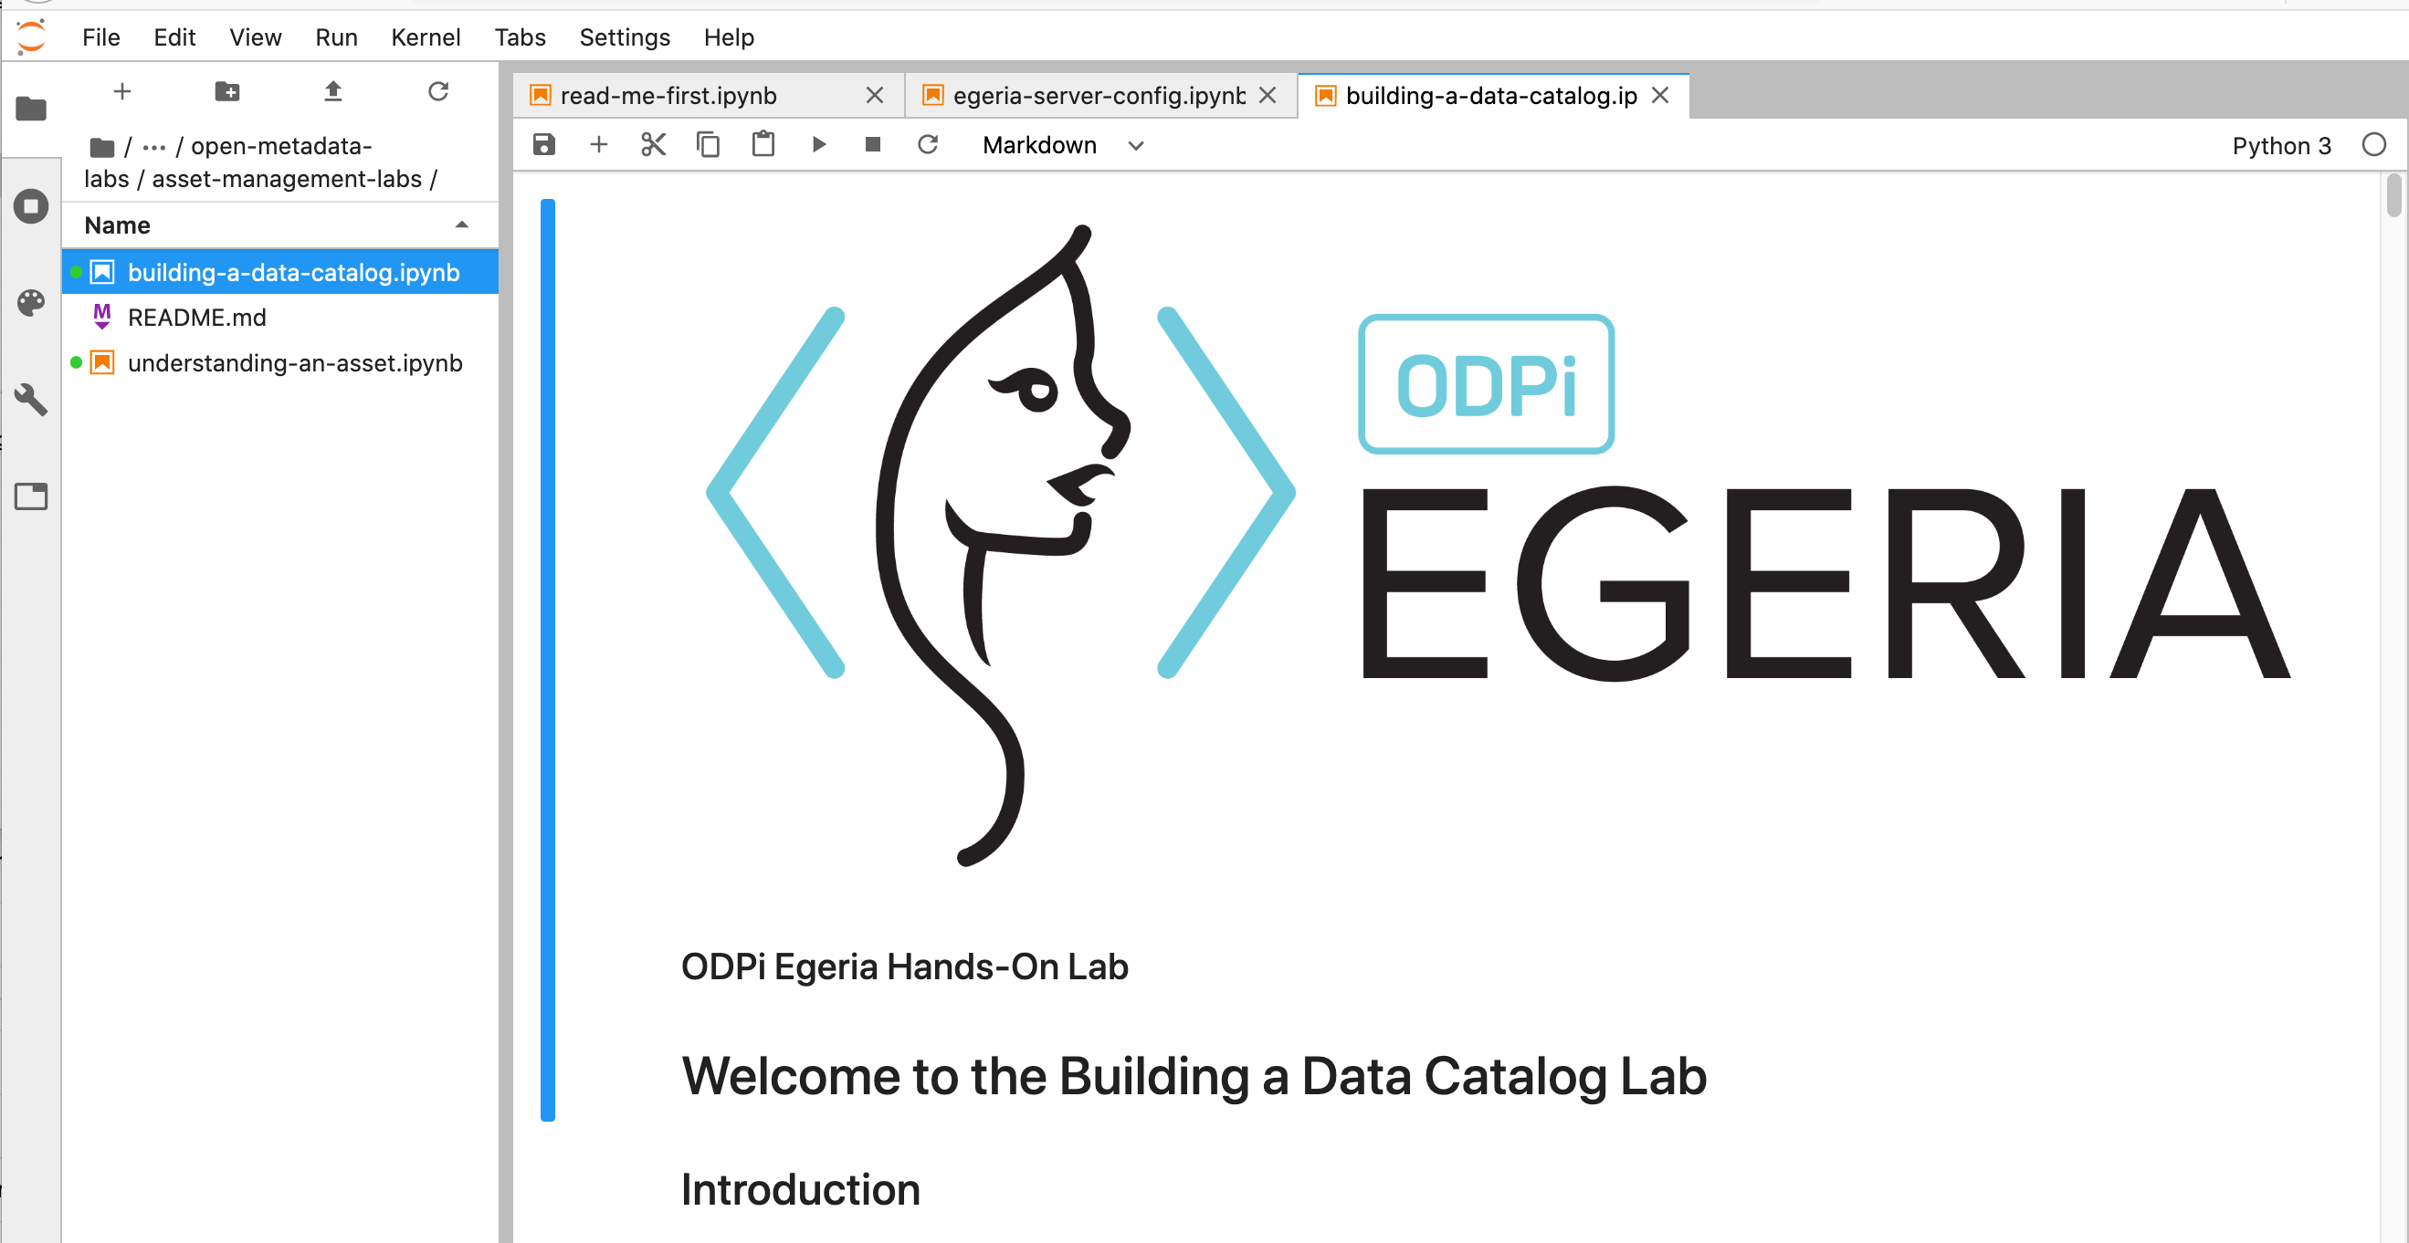
Open Metadata Labs

Slide 69
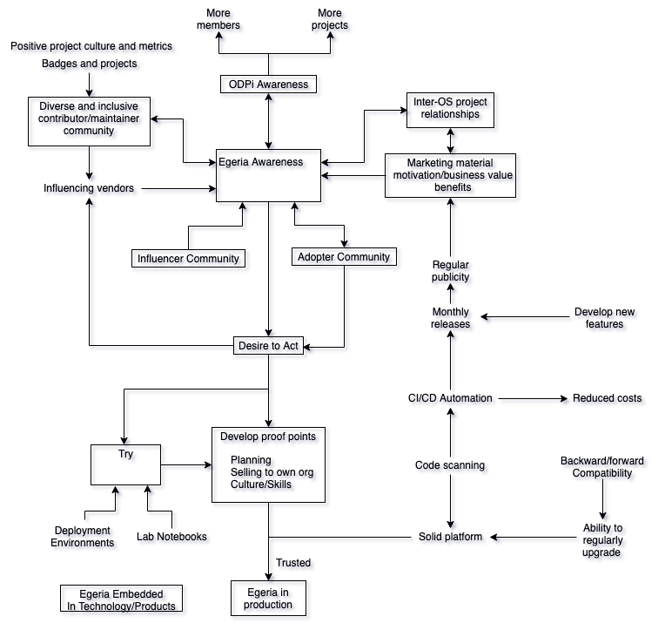
Building Egeria maturity

Slide 70
Open forum
z
z
z
z
z
z
z
Questions?

Slide 71
Egeria Summary
Open Metadata Ecosystem
Open Source
Open Standards
Heterogeneous interoperability between third party tools
Comprehensive coverage of digital activities
Focus on automation
Digital
Services
Development
Data Lake
Operations
Chief Data Office
Analytics
DevOps

Slide 72
Links
Press Releases and Podcast
Open source repositories
https://www.linuxfoundation.org/press-release/2018/08/odpi-announces-egeria-for-open-sharing-exchange-and-governance-of-metadata/
https://www.linuxfoundation.org/press-release/2019/02/odpi-announces-new-egeria-conformance-program-to-advance-open-metadata-exchange-between-vendor-tools/
https://roaringelephant.org/2018/09/25/episode-107-open-metadata-and-governance-masterclass-with-mandy-chessell-part-1/
https://roaringelephant.org/2018/10/09/episode-109-open-metadata-and-governance-
masterclass-with-mandy-chessell-part-2/
https://youtu.be/ryd3KFWT1mc
https://github.com/odpi/data-governance
https://github.com/odpi/egeria
72

